Slide 2
E-Governance Smart City Geographical Information System(GIS)

Slide 3
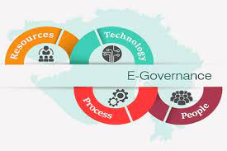
E-Governance

Slide 4
E-Governance
E-Governance expands to Electronic Governance.
Application of ICT(Information and Communication Technology) for delivering government services.
Enhancement of traditional government.
Delivers SMART government.
S-Smart
M-Moral
A-Accessible
R-Responsive
T-Transparent

Slide 5
Purpose of e-governance
To promote good governance.
To simplify government procedures.
To access to government services.
To enhance ability to address public needs.

Slide 6
Models of e-governance
G2C(Government to Citizens)
G2B(Government to Business)
G2E(Government to Employees)
G2G(Government to Government)
Exchange of Information between government agencies.
Interactions may be diplomatic ties,economic alliance etc.
Improves efficiency in data sharing.

